Slide 1
Introduction to JQuery

Slide 2
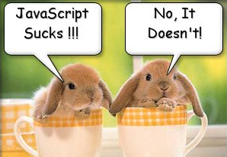
What’s the problem with JavaScript?

Slide 3
JavaScript was a initially introduced in Netscape 2 in Dec 1995,
a.k.a. Mocha, LiveScript, Jscript, however, it’s official name is
ECMAScript

Slide 4
JavaScript is a C-family, world’s worst named, extremely powerful language for web interaction, totally unrelated to Java

Slide 5
JavaScript is a weakly typed, prototype based language, that can also be used outside the browser. It is not a browser DOM.

Slide 6

Browser DOM is boring, and this is where jQuery comes to rescue.

Slide 7

This session is about improving your Quality of Life !

Slide 8

Introduction to jQuery

Slide 9
A Quality of Life by jQuery:
$(“#firstName”).text(“Joe Black”);
$(“button”).click(function() {alert “Clicked”;});
$(“.content”).hide();
$(“#main”).load(“content.htm”);
$(“<div/>”).html(“Loading…”).appendTo(“#content”);
Very compact and fluent programming model

Slide 10
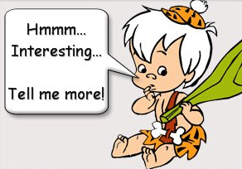
What is jQuery?

Slide 11
jQuery is a lightweight, open-source JavaScript library that simplifies interaction between HTML and JavaScript

Slide 12

It was and still being developed
by John Resig from Mozilla and was first announced in January 2006

Slide 13
It has a great community, great documentation, tons of plugins, and it was recently adopted by Microsoft
(how about intellisense in VS?)

Slide 14

The current version is 2.1.0
(as of Jan 2014)

Slide 15
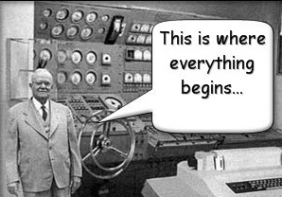
Getting Started

Slide 16
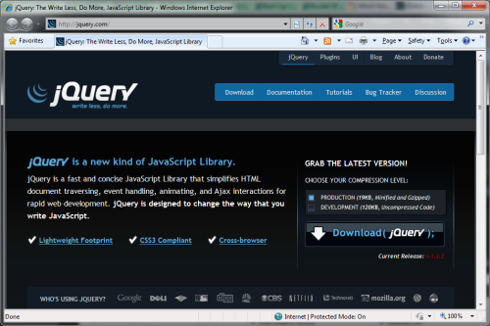
Download the latest version from
http://jquery.com

Slide 17
Reference it in your markup
  <script src=“jquery.js”/>

Slide 18
Reference it in your JS files:
  ///<reference path=“jquery.js”/>
… or just drag it into the file

Slide 19
You can also reference it from Google
  <script src=“http://ajax.googleapis.com/
  ajax/libs/jquery/1.2.6/
  jquery.min.js”>
  </script>

Slide 20
jQuery Core Concepts

Slide 21
The Magic $() function
  var el = $(“<div/>”)
Create HTML elements on the fly

Slide 22
The Magic $() function
  $(window).width()
Manipulate existing DOM elements

Slide 23
The Magic $() function
  $(“div”).hide();
  $(“div”, $(“p”)).hide();
Selects document elements
(more in a moment…)

Slide 24
The Magic $() function
  $(function(){…});
Fired when the document is ready for programming.
Better use the full syntax:
  $(document).ready(function(){…});

Slide 25
The full name of $() function is
  jQuery();
It may be used in case of conflict with other frameworks.

Slide 26
Avoid $() conflict with other frameworks
  var foo = jQuery.noConflict();
  // now foo() is the jQuery main function
  foo(“div”).hide();
  // remove the conflicting $ and jQuery
  var foo = jQuery.noConflict(true);

Slide 27
jQuery’s programming philosophy is:
GET >> ACT
  $(“div”).hide()
  $(“<span/>”).appendTo(“body”)
  $(“:button”).click()

Slide 28
Almost every function returns jQuery, which provides a fluent programming interface and chainability:
  $(“div”).show()
  .addClass(“main”)
  .html(“Hello jQuery”);

Slide 29


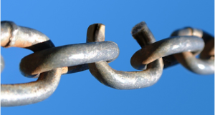
Three Major Concepts of jQuery
The $() function
Get > Act
Chainability

Slide 30

jQuery Selectors

Slide 31
All Selector
  $(“*”) // find everything
Selectors return a pseudo-array of jQuery elements

Slide 32
Basic Selectors
By Tag:
  $(“div”)
  // <div>Hello jQuery</div>
By ID:
  $(“#usr”)
  // <span id=“usr”>John</span>
By Class:
  $(“.menu”)
  // <ul class=“menu”>Home</ul>
Yes, jQuery implements CSS Selectors!

Slide 33
More Precise Selectors
  $(“div.main”) // tag and class
  $(“table#data”) // tag and id

Slide 34
Combination of Selectors
  // find by id , by class
  $(“#content, .menu”)
  // multiple combination
  $(“h1, h2, h3, div.content”)

Slide 35
Hierarchy Selectors
  $(“table td”) // descendants
  $(“tr > td”) // children
  $(“#content ~ div”) // siblings

Slide 36
Selection Index Filters
  $(“tr:first”) // first element
  $(“tr:last”) // last element
  $(“tr:lt(2)”) // index less than
  $(“tr:gt(2)”) // index gr. than
  $(“tr:eq(2)”) // index equals

Slide 37
Visibility Filters
  $(“div:visible”) // if visible
  $(“div:hidden”) // if not

Slide 38
Attribute Filters
  $(“div[id]”) // has attribute
  $(“div[dir=‘rtl’]”) // equals to
  $(“div[id^=‘main’]”) // starts with
  $(“div[id$=‘name’]”) // ends with
  $(“a[href*=‘msdn’]”) // contains

Slide 39
Forms Selectors
  $(“input:checkbox”) // checkboxes
  $(“input:radio”) // radio buttons
  $(“:button”) // buttons
  $(“:text”) // text inputs

Slide 40
Forms Selectors / Filters
  $(“input:checked”) // checked
  $(“input:selected”) // selected
  $(“input:enabled”) // enabled
  $(“input:disabled”) // disabled

Slide 41
Find Dropdown Selected Item
  <select name=“cities”>
    <option value=“1”>Tel-Aviv</option>
    <option value=“2” selected=“selected”>Yavne</option>
    <option value=“3”>Raanana</option>
  </select>
  $(“select[name=‘cities’] option:selected”).val()

Slide 42
SELECTORS DEMO

Slide 43


Slide 44
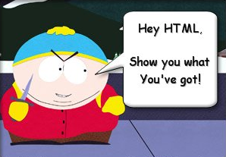
Document Traversal

Slide 45
A Selector returns a pseudo array of jQuery objects
  $(“div”).length
Returns number of selected elements.
It is the best way to check selector.

Slide 46
Getting a specific DOM element
  $(“div”).get(2) or $(“div”)[2]
Returns a 2nd DOM element of the selection

Slide 47
Getting a specific jQuery element
  $(“div”).eq(2)
Returns a 2nd jQuery element of the selection

Slide 48
each(fn) traverses every selected element calling fn()
  var sum = 0;
  $(“div.number”).each(
  function(){
  sum += (+this.innerHTML);
  });
this – is a current DOM element

Slide 49
each(fn) also passes an indexer
  $(“table tr”).each(
  function(i){
  if (i % 2)
  $(this).addClass(“odd”);
  });
$(this) – convert DOM to jQuery
i - index of the current element

Slide 50
Traversing HTML
  .next(expr) // next sibling
  .prev(expr) // previous sibling
  .siblings(expr) // siblings
  .children(expr) // children
  .parent(expr) // parent

Slide 51
Find in selected
  // select paragraph and then find
  // elements with class ‘header’ inside
  $(“p”).find(“.header”).show();

Slide 52
Get Part of Selected Result
  $(“div”)
  .slice(2, 5)
  .not(“.green”)
  .addClass(“middle”);

Slide 53
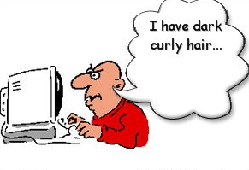
HTML Manipulation

Slide 54
Getting and Setting Inner Content
  $(“p”).html(“<div>Hello $!</div>”);
  // escape the content of div.b
  $(“div.a”).text($(“div.b”).html());

Slide 55
Getting and Setting Values
  // get the value of the checked checkbox
  $(“input:checkbox:checked”).val();
  // set the value of the textbox
  $(“:text[name=‘txt’]”).val(“Hello”);

Slide 56
Handling CSS Classes
  // add and remove class
  $(“p”).removeClass(“blue”).addClass(“red”);
  // add if absent, remove otherwise
  $(“div”).toggleClass(“main”);
  // test for class existance
  if ($(“div”).hasClass(“main”)) { //… }

Slide 57
Inserting new Elements
  // select > append to the end
  $(“h1”).append(“<li>Hello $!</li>”);
  // select > append to the beginning
  $(“ul”).prepend(“<li>Hello $!</li>”);
  // create > append/prepend to selector
  $(“<li/>”).html(“9”).appendTo(“ul”);
  $(“<li/>”).html(“1”).prependTo(“ul”);

Slide 58
Replacing Elements
  // select > replace
  $(“h1”).replaceWith(“<div>Hello</div>”);
  // create > replace selection
  $(“<div>Hello</div>”).replaceAll(“h1”);

Slide 59
Replacing Elements while keeping the content
  $(“h3”).each(function(){
  $(this).replaceWith(“<div>” + $(this).html()
  + ”</div>”);
  });

Slide 60
Deleting Elements
  // remove all children
  $(“#mainContent”).empty();
  // remove selection
  $(“span.names”).remove();

Slide 61
Handling attributes
  $(“a”).attr(“href”,”home.htm”);
  // <a href=“home.htm”>…</a>
  $(“button:gt(0)”).attr(“disabled”, $(“button:eq(0)”).attr(“disabled));
  // remove attribute - enable
  $(“button”).removeAttr(“disabled”)

Slide 62
Setting multiple attributes
  $(“img”).attr({
  “src” : “/images/smile.jpg”,
  “alt” : “Smile”,
  “width” : 10,
  “height” : 10
  });

Slide 63
CSS Manipulations
  // get style
  $(“div”).css(“background-color”);
  // set style
  $(“div”).css(“float”, “left”);
  // set multiple style properties
  $(“div”).css({“color”:”blue”,
  “padding”: “1em”
  “margin-right”: “0”,
  marginLeft: “10px”});

Slide 64
Dimensions
  // get window height
  var winHeight = $(window).height();
  // set element height
  $(“#main”).height(winHeight);
  //.width() – element
  //.innerWidth() – .width() + padding
  //.outerWidth() – .innerWidth() + border
  //.outerWidth(true) – including margin
The default unit is Pixel (px)

Slide 65
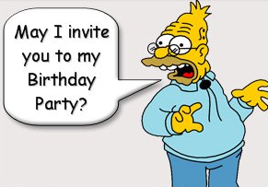
Events

Slide 66
When the DOM is ready…
  $(document).ready(function(){
  //…
  });
Fires when the document is ready for programming.
window.onload() is a fallback.

Slide 67
Attach Event
  // execute always
  $(“div”).bind(“click”, fn);
  // execute only once
  $(“div”).one(“click”, fn);
Possible event values:
blur, focus, load, resize, scroll, unload, beforeunload, click, dblclick, mousedown, mouseup, mousemove, mouseover, mouseout, mouseenter, mouseleave, change, select, submit, keydown, keypress, keyup, error

Slide 68
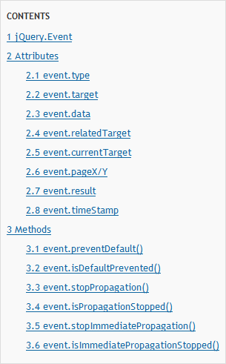
jQuery.Event object

Slide 69
Detaching Events
  $(“div”).unbind(“click”, fn);

Slide 70
Events Triggering
  $(“div”).trigger(“click”);
Triggers browser’s event action as well.

Slide 71
Events Helpers
  // attach / trigger
  elem.blur(fn) / elem.blur()
  elem.focus(fn) / elem.focus()
  elem.click(fn) / elem.click()
  elem.change(fn) / elem.change()
And many others…

Slide 72
Preventing Browser Default Action
  // prevent default action in handler
  function clickHandler(e) {
  e.preventDefault();
  }
  // or just return false
  function clickHandler(e) {return false;}

Slide 73
Live Events
  // attach live event
  (“div”).live(“click”, fn);
  // detach live event
  (“div”).die(“click”, fn);
Currently supported events:
click, dblclick, mousedown, mouseup, mousemove, mouseover, mouseout, keydown, keypress, keyup

Slide 74
EVENTS DEMO

Slide 75
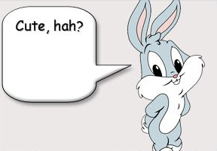
Effects

Slide 76
Showing or Hiding Element
  // just show
  $(“div”).show();
  // reveal slowly, slow=600ms
  $(“div”).show(“slow”);
  // hide fast, fast=200ms
  $(“div”).hide(“fast”);
  // hide or show in 100ms $(“div”).toggle(100);

Slide 77
Sliding Elements
  $(“div”).slideUp();
  $(“div”).slideDown(“fast”);
  $(“div”).slideToggle(1000);

Slide 78
Fading Elements
  $(“div”).fadeIn(“fast”);
  $(“div”).fadeOut(“normal”);
  // fade to a custom opacity
  $(“div”).fadeTo (“fast”, 0.5);
Fading === changing opacity

Slide 79
Detecting animation completion
  $(“div”).hide(“slow”, function() {
  alert(“The DIV is hidden”);
  });
  $(“div”).show(“fast”, function() {
  $(this).html(“Hello jQuery”);
  }); // this is a current DOM element
Every effect function has a (speed, callback) overload

Slide 80
Custom Animation
  // .animate(options, duration)
  $(“div”).animate({
  width: “90%”,
  opacity: 0.5,
  borderWidth: “5px”
  }, 1000);

Slide 81
Chaining Animation
  $(“div”).animate({width: “90%”},100)
  .animate({opacity: 0.5},200)
  .animate({borderWidth: “5px”});
By default animations are queued and than performed one by one

Slide 82
EFFECTS DEMO

Slide 83

AJAX with jQuery

Slide 84
Loading content
  $(“div”).load(“content.htm”);
  // passing parameters
  $(“#content”).load(“getcontent.aspx”,
  {“id”:”33”, “type”:”main”});

Slide 85
Sending GET/POST requests
  $.get(“test.aspx”, {id:1},
  function(data){alert(data);});
  $.post(“test.aspx”, {id:1},
  function(data){alert(data);});

Slide 86
Retrieving JSON Data
  $.getJSON(“users.aspx”, {id:1},
  function(users)
  {
  alert(users[0].name);
  });

Slide 87
Retrieving JS Files
  $.getScript(“script.js”,
  function()
  {
  doSomeFunction();
  });

Slide 88
AJAX DEMO

Slide 89

Where to go next
jQuery web-site: http://jquery.com
jQuery API: http://api.jquery.com
Many many blogs
jQuery in Action book:

Slide 90
Thank YOU!

